Slide 1
CIS Automation Practice

Slide 2







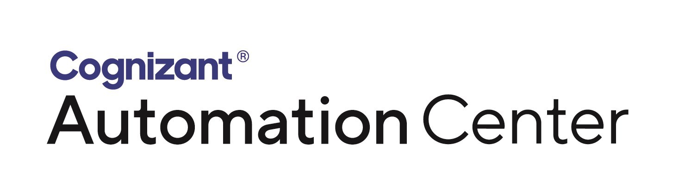



Automation Practice
Practice Accolades
Practice Snapshot
50+
Customers supported across geographies and Industry Verticals
100+
Professionals with diversified expertise on infrastructure automation with above 10 + Years of Relevant Experience
Dedicated team of Automation Architects and Specialists with consulting, Solutioning, design, implementation and integration expertise
15+ Years of Domain Experience
100+ Seasoned Experts
50+ Projects
60% of Associates are Certified on various automation tools, platform and ITIL processes
Dedicated CoE to drive process and technology Innovations and transformation
End-to-End infrastructure automation service using various tools and technologies
Partners and Open Standards

Slide 3
Cognizant Automation Continuum Siloed to Intelligent Automation for Agility
Script based approach / Point Automation
(siloed)
ITPA / RPA tools approach
(siloed -> Integrated)
AI Enabled Automation
(Business aligned Integrated IT Automation)
Systems that Do
Systems that Think/Learn/Interact
Automation Journey powered by AI/ML capability
Automate for efficiency & IT user Experience
Human in Ops Loop
Automation of Run Ops across Infra and App
ITPA, Cognitive & AI Led Operations
Automate for Agility
Human in the Digital Loop
AI Led Engineering Automation
Cloud Infra / Code /Devops /QA/Agile Pipeline

Slide 4
Enterprise Automation - Capability
Automation Service Portfolio
Domains
Script Based Automation
IT Process Automation (ITPA)
Service Requests
Incidents
Standard Changes
Health Checks and Reports
Build and Patching
Robotic Process Automation
AI / ML Based Intelligent Automation
Interactive Automation (Chat Bots)
Hybrid Cloud
Public Cloud
End User Computing
Service Desk
Security

Slide 5
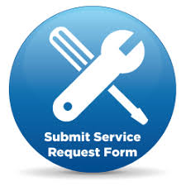



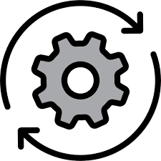

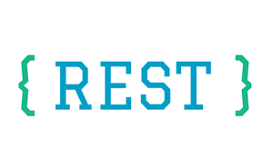



Enterprise Automation Platform Integration Approach
Scripts
Runbooks
RPA BOTs
Service Requests
Automated Workflows
AI / ML Powered
Recommendation
Reactive Tickets
{ Event Driven }
SME Driven
Machine Assisted Automation
Proactive Tickets
Release Automation
Build Automation
Patch Automation
Configuration Management
Continuous Integration
Event Corelation
Automation Triggers
Systems of Record
Automation Orchestration
Automation Endpoints
Note: Product names are indicative

Slide 6
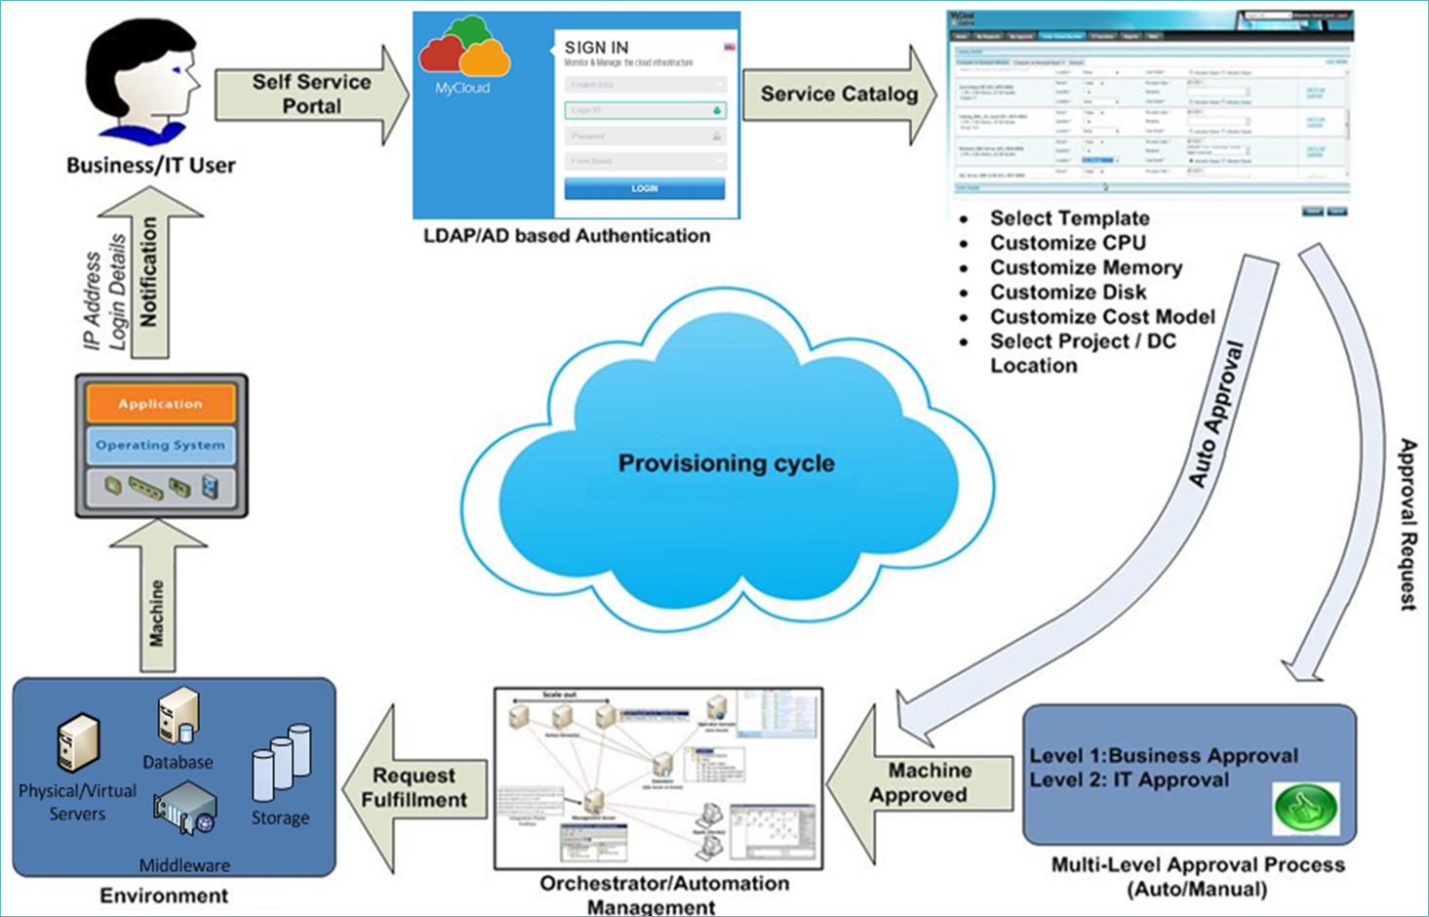
Sample: VM Provisioning – Automation use case

Slide 7
Thank you

